Slide 1
AI Search Algorithms
Author: Alex Tabacaru

Slide 2
Folder Structure
Maps folder → place for 2D & 3D map files → map files can be downloaded from: https://www.movingai.com/ maps can be also forged manually or via script, the map files format is simple and self explanatory.
SearchAIBenchMark folder → the source code , JAVA language.

Slide 3
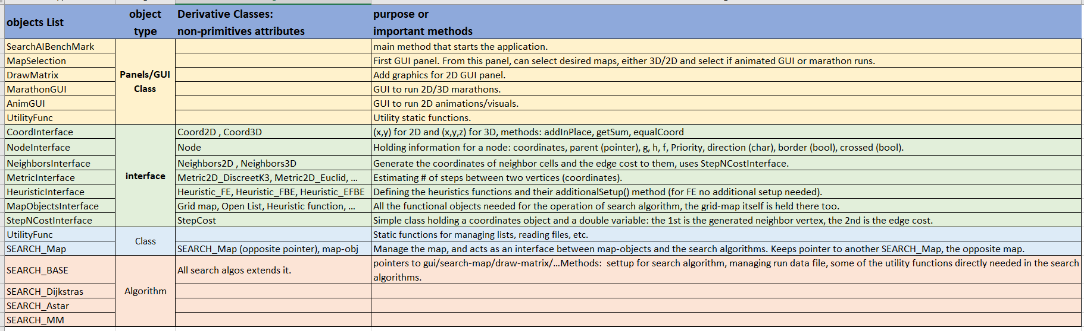
Code Structure

Slide 4
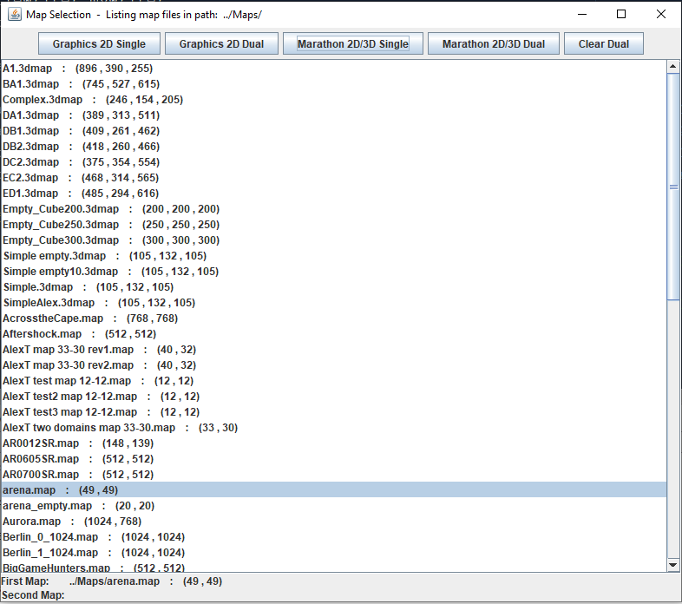
Main GUI screen
4 buttons:
The buttons are self explanatory.
If need to run in dual mode, need to select first map then click on the button, then select other map and click on the button again.
At bottom of window it is presenting the selection done so far.

Slide 5
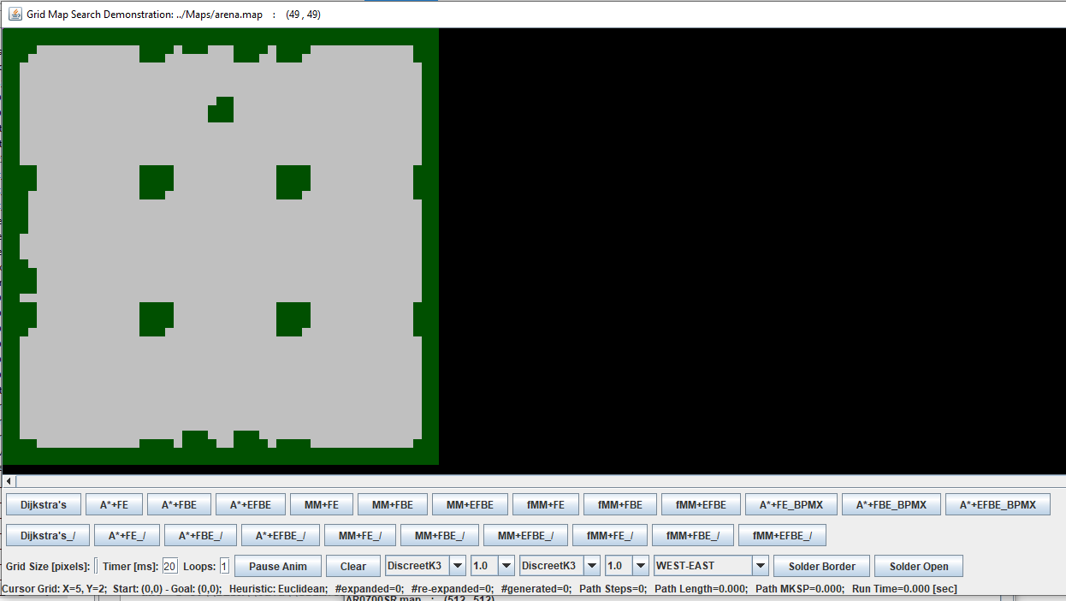
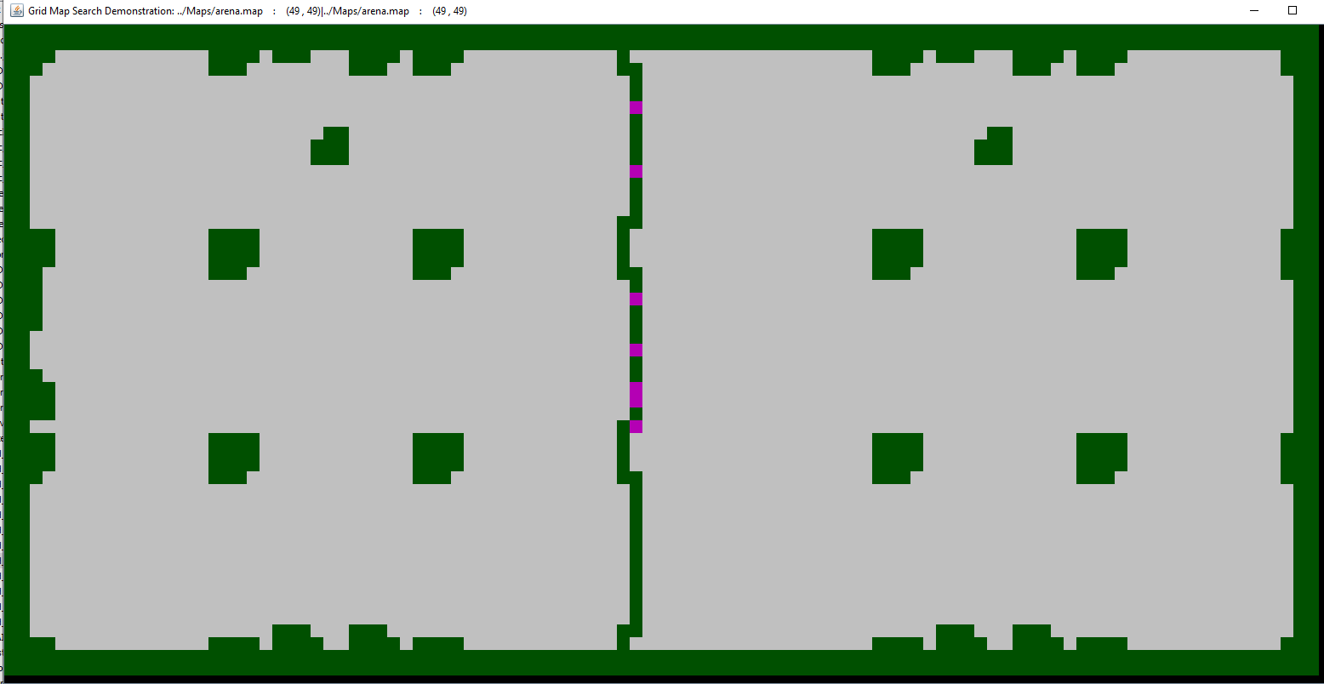
Code: important Classes & notes
Can select weights, neighbor type (default DiscreetK3), grid pixel size.
First row of buttons are for regular algorithm runs, combined with the different heuristics.
Second row, is for animation versions, showing the search as it progresses.
Timer [ms]: to define how fast the animation goes. It is accelerating during the search to allow better timing.
Solder Border: if dual map, can solder the maps and add the border nodes.
Solder Open: if dual map, same as above but leaves the bordr places as terrain for free passage.
Soldered dual map (same map in this case).
Class attribute BD will define the density of the borders along the soldered line.
Define composition for each side.
MAP_COMPOSING_ROWS
MAP_COMPOSING_COLS

Slide 6
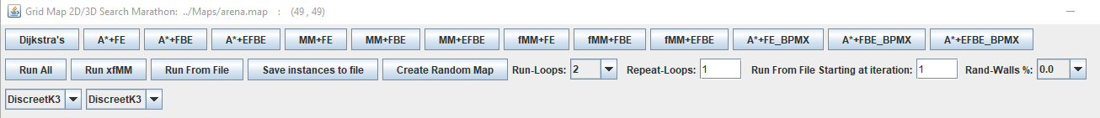
Code: important Classes & notes
Class MarathonGUI → responsible for running marathons (see screenshot at the bottom of slide).
A useful and quality method to run the marathons is by creating a “run” file. Then it can be repeated (run) from the file.
Notice the run file name includes the map names (also for dual maps mode).
Most useable buttons and fields:
Repeat-Loops field → how many iterations of new starting locations will be generated in the run file.
Save instances to file button → generate the run file. The generation parameters are defined inside the handler event: saveInstancesToFile double[] wL = { 1.0, 1.25, 1.5, 2.0, 4.0, 6.0, 10.0 } for weight factors on west map (if dual mode). double[] brL = { 1.0, 0.4, 0.2, 0.1, 0.01} for border Density (or ratio, if dual mode). it is important to keep the brL in descending order, it is working its way down, this is done in order to save disk space in the run file, removing border nodes from one level up. double randStartGoal = 0.8 parameter to define how far into the map the new starting locations are set.

Slide 7
Code: important Classes & notes
Most useable buttons and fields – continue:
Run From File button → start running the marathon from a file.
The algorithms button in first row of buttons is to allow run one algorithm on one instance, the instance is defined by the other fields.
The DiscreetK3 combo box selection is for the type of neighbors, type of steps during search.
The program might need fine tuning for the rest of the buttons.

Slide 8
Code: important Classes & notes
Class AnimGui → for 2D graphics and animation, add/remove algorithms from the list in the function: reInstantiateSearchObjects()
There are 2 types of algorithms there → 2 lists.
One, regular for statistics record, and animation mode for visualization.
The difference between the two versions of algorithms is simple: for animation need to add
implements Runnable in class definition title.
Add (or copy from existing) the override function run()
Add the function call animThread() at a step where you want to have the graphics updated. In this repo, I put all of them in same place.

Slide 9
Code: important Classes & notes
User can define the project memory/heap size, for very large maps or algorithms that generate additional data for each node which will result in large memory requirement, this will be needed.

